Slide 1
SOLID PRINCIPLES
Better way to code
PRESENTATION BY
JATIN DAVE

Slide 2
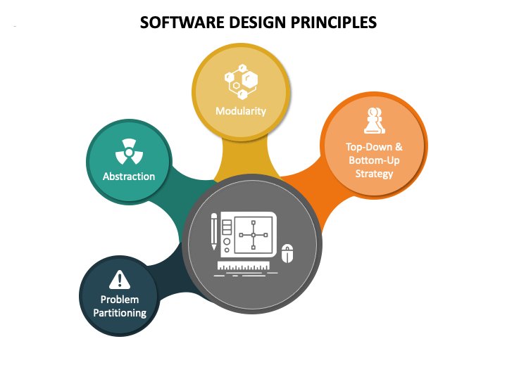
SOFTWARE DESIGN PRINCIPLES
Design principle is a framework for the designer to follow as good software practices.
Design principles provide high level guidelines to design better software applications.
They do not provide implementation guidelines and are not bound to any programming language.
The SOLID (SRP, OCP, LSP, ISP, DIP) principles are one of the most popular sets of design principles.

Slide 3
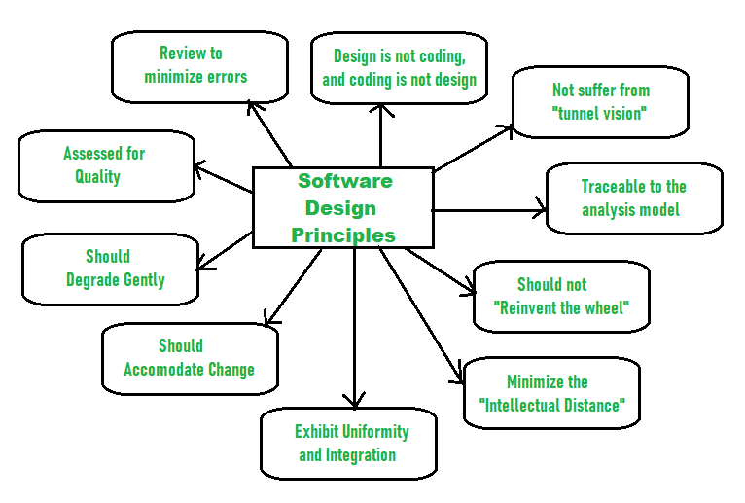
WHY NEED OF SOFTWARE DESIGN PRINCIPLES?
Software designs is a process to plan or convert the software requirements into software systems. There are several principles are used to organize and arrange structural component of software design.
Should not suffer from “Tunnel Vision” – Not only focus on completeness but also on other effects.
Traceable to analysis model - Fulfill all requirements.
Should not “Reinvent The Wheel” - Should not waste time or effort in creating things that already exist.
Minimize Intellectual distance - Reduce the gap between real-world problems and software solutions. (Follow standard practices)
Exhibit uniformity and integration- Uniform design throughout the process without any change.

Slide 4
WHY NEED OF SOFTWARE DESIGN PRINCIPLES?
Accommodate change – Adjust the change as per user’s need.
Degrade gently - Work properly even if an error occurs during the execution.
Assessed for quality - The quality of the design needs to be checked and focused.
Review to discover errors – Review design timely to minimize errors
Design is not coding and coding is not design – Design is describing the logic of program and coding is implementation of design

Slide 5
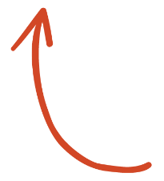
EXCITED ?
You are boring

Slide 6
EXCERSISE TIME (1 minute)
Definition :
Design class to deliver below responsibilities,
Generate Report
Export Report
Print Report
Review:
Keep it with you, Review yourself after the session.
Not Interested

Slide 7
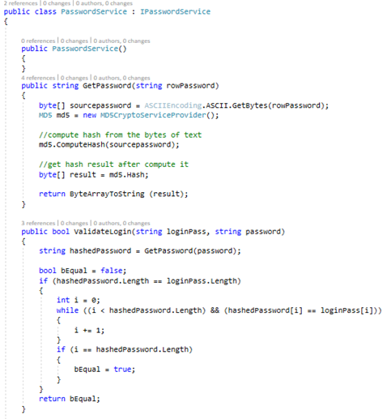

REVISIT - INTERFACE
Contract between itself and any class that implements it.
It contains only declaration of its members and Implementor must implement all of interface members.

Slide 8
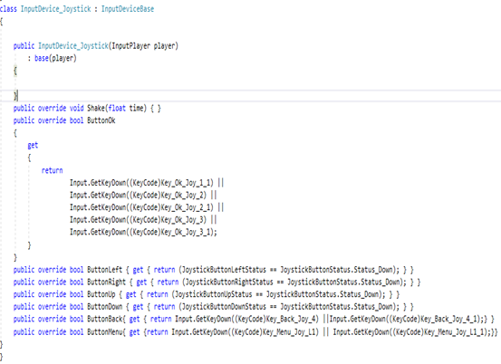
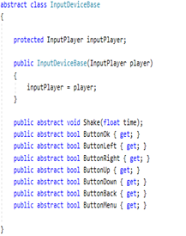
REVISIT - ABSTRACTION
An instance of an abstract class can not be created.
A class inherits from the abstract class need to implement all its abstract members.
Abstract class can contain non abstract methods but at least one abstract method.

Slide 9
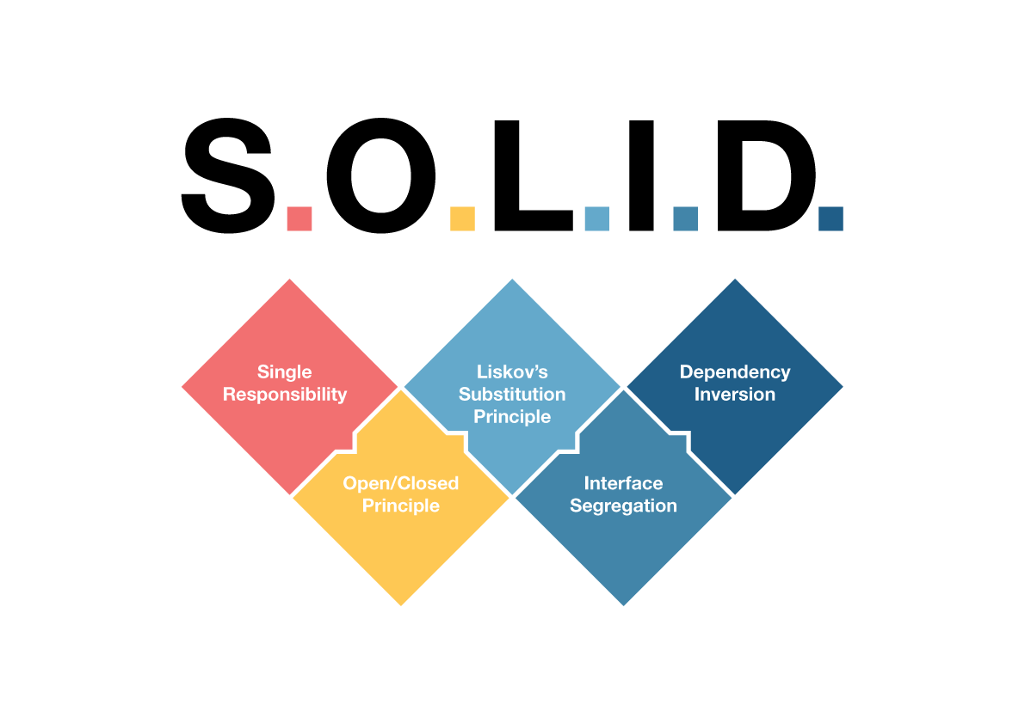
SOLID PRINCIPLES
SOLID Design principles are Introduced by Robert. C. Martin. The SOLID software principles will guide you to:
Write code that’s easy to maintain.
Make it easier to extend the existing system.
Write code that’s easy to read and understand.
S
SINGLE RESPONSIBILITY PRINCIPLE
O
OPEN/CLOSED PRINCIPLE
L
LISKOV SUBSTITUTION PRINCIPLE
I
INTERFACE SEGREGATION PRINCIPLE
D
DEPENDENCY INVERSION PRINCIPLE

Slide 10
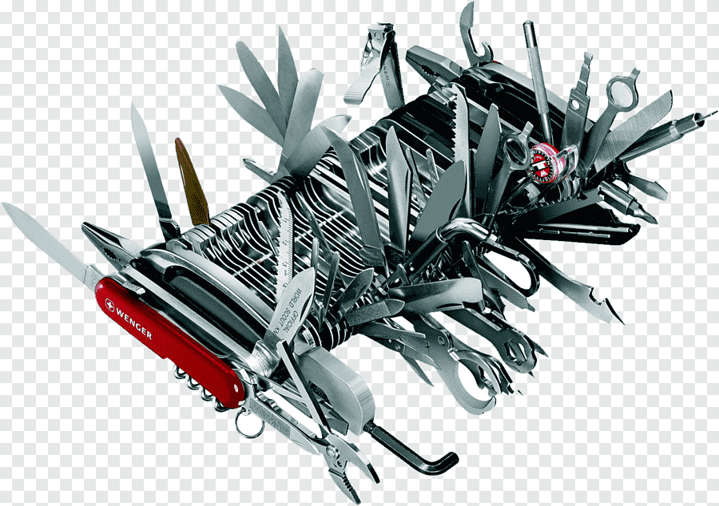
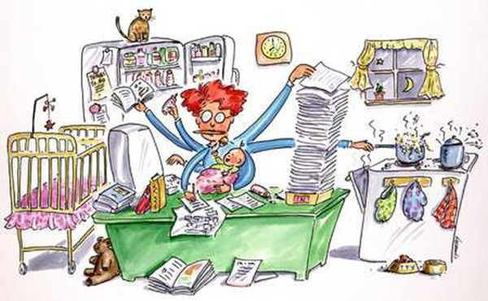
SINGLE RESPONSIBILITY PRINCIPLE
A class (or method) should only have one responsibility hence only one reason to change.
Misinterpretation – Most developers interpret to mean that a class should perform only one task. But it's not only classes, functions you implement in code during development should also perform only one task. So one should interpret it as meaning that an implementation should perform only one task.
Benefits:
Easier to understand for a new teammate.
Maintain is easy as it change less frequently.
Easier to Test
How to determine?
Class description should not contain words like “And , Or, But or If”.
Class constructor/method contains too many parameters.

Slide 11
DEMO
INTERSTING !!!

Slide 12
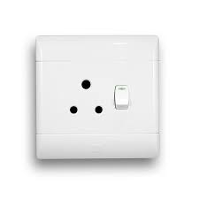
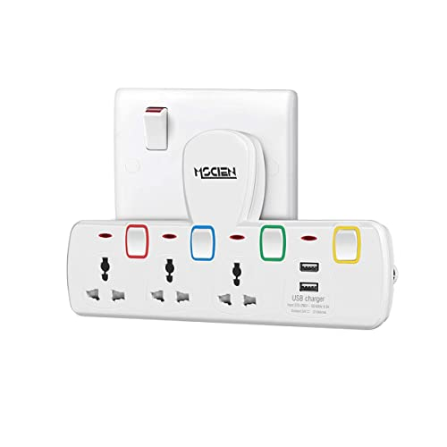

OPEN /CLOSED PRINCIPLE
Software entities (classes, modules, functions, etc.) should be open for extension, but closed for modification
Once Implementation completed, should be closed for further modification.
Wall fitted adapter is closed for modification, but another extension board can fulfill extension.
Benefits:
Not allowing modification limits introducing new bugs
All dependent classes will not need to adapt modification.
How to determine?
Class or function is always open for modification, It should always allow to add more logic to it.

Slide 13
DEMO
JUST WOW !!!

Slide 14
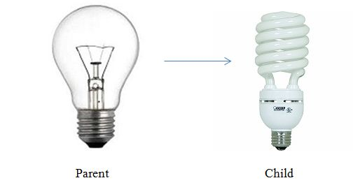
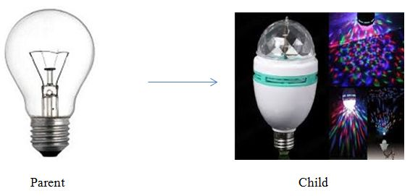
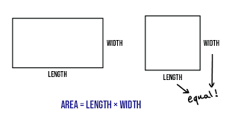
LISKOV SUBSTITUTION PRINCIPLE
Perfect Substitution
Defined by Barbara Liskov.
Principle is based on inheritance which states that derived classes should be able to extend their base classes without changing/affecting their behavior.
Consume a service of a base class, must work correctly when the base class object is replaced by a child class (derived class) object.
Benefits:
No surprising behavior (Run time Exception) for callers when substitution applies.
Code reusable and loosely coupled.
How to determine ?
Verify the inheritance tree, Child classes inherited from the parent class should not break the functionality of a parent class.
It is an extension of the Open Close Principle and is violated when you have written code that throws "not implemented exceptions"
Violation Substitution

Slide 15
DEMO
Hmm !!!

Slide 16
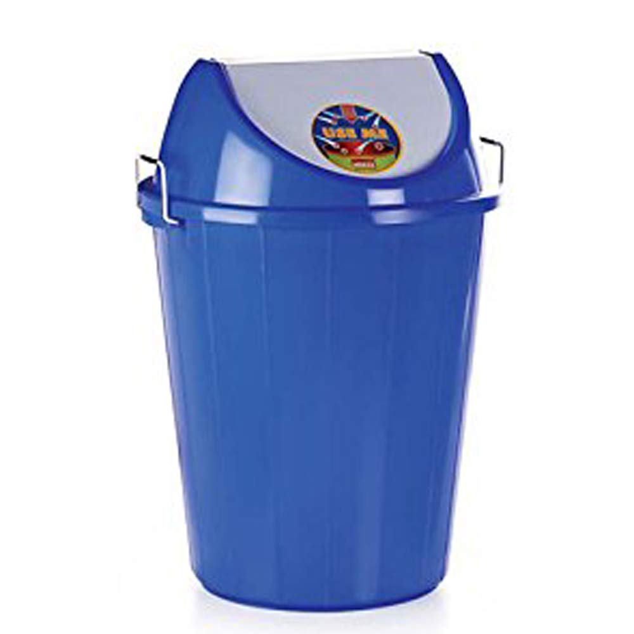
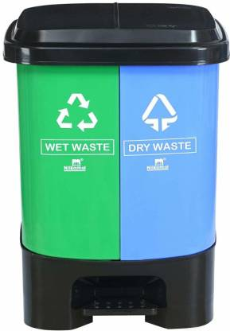
INTERFACE SEGREGATION PRINCIPLE
Client (class implementation interface) should not force to implement Interface that they don't use.
Do not design a big fat interface that forces the client to implement a method that is not required by it, instead design a small interface.
Implement the required set of interface.
Big fat interface should break into a set of small interfaces with the related method(s) in it.
It's similar to normalizing our database, like normalizing database from one NF to required NF where a big table is broken into tables with related columns.
Benefits:
Normalizing code.
Easier to manage and test.
How to determine?
Forces the client to implement a method that is not required
The client interface ends up violating SRP

Slide 17
DEMO
Excellent !!!

Slide 18
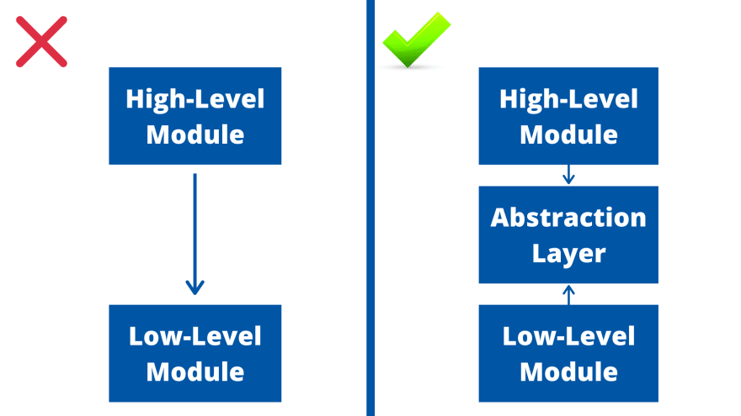
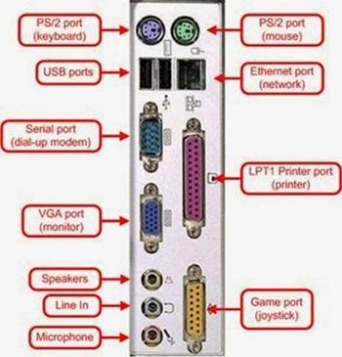

DEPENDENCY INVERSION PRINCIPLE
High-level modules should not depend on low level modules and vice versa, both should depend upon abstraction.
Abstractions should not depend upon details. Details should depend upon abstractions.
Low-level : It contains the details.
Hight-Level: The code is dealing with policies, business rules and the bigger picture.
Change in a low-level module, we want to prevent that we also need to make changes a high-level module
No tight coupling should be among components (Viz. modules, classes) of software and to avoid that, they should depend on abstraction.
Benefits:
Parallel development of the module becomes easy
Allow mock testing efficiently.

Slide 19
DEMO
Yeh kya bol raha he?
Kab tak chalega?

Slide 20
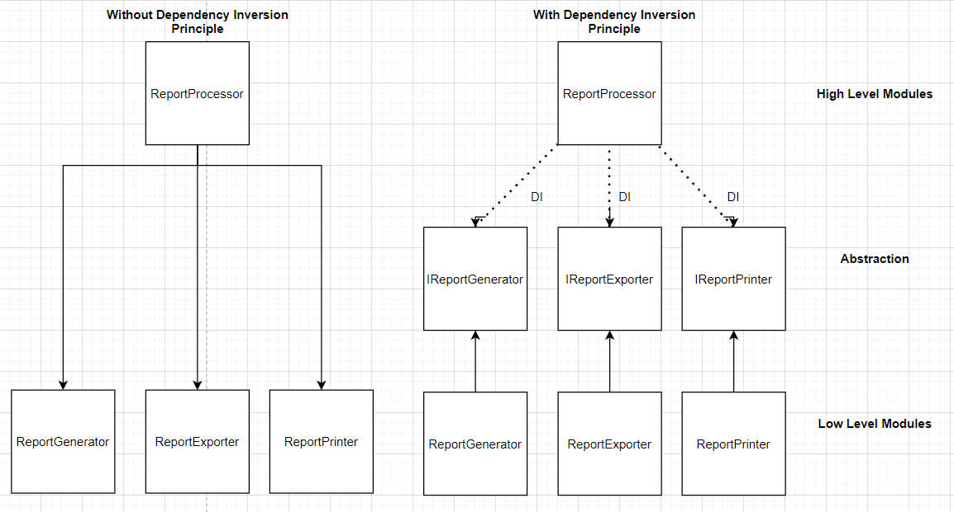
DEPENDENCY INJECTION
It is a pattern of injecting a class’s dependencies into it at runtime.
Constructor Injection
Property Injection
Benefit:
This allows you to swap in different implementor without having to modify the main class.
Before Change
After Change

Slide 21


Any Questions?
Github Code Link
Good Reads,
SOLID PRINCIPLES

